Slide 1
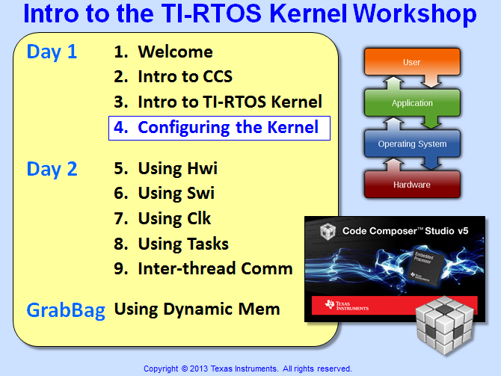

Slide 2
Objectives
Learn how to create a new SYS/BIOS project
Understand how to create and configure BIOS objects using the .cfg file and GUI editor
Analyze the timeline of events in a BIOS system
Explore the built-in Visibility/Debug tools (UIA)
Lab – Create, build and debug a TI-RTOS kernel application that blinks an LED

Slide 3
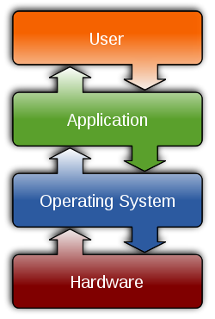
Outline
Creating A New Project
TI-RTOS Config (.CFG)
System Timeline
UIA & RTOS Analyzer
Version Control
Lab

Slide 4
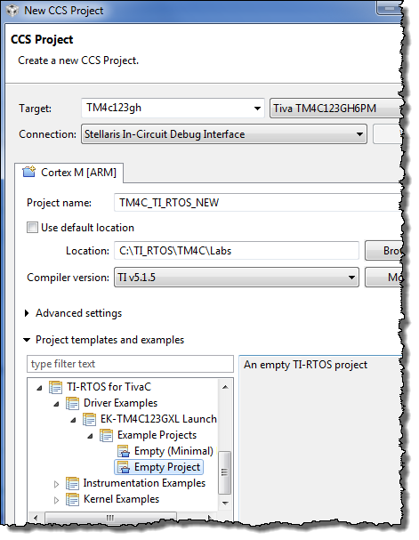

Creating a New TI-RTOS Project
Create CCS Project
Same as before except…
You need to choose a TI-RTOS project template
“Driver” Project Template
empty.c that contains #includes for header files and some starter “driver” code
BIOS Config file (empty.cfg) – contains UIA and “starter” BIOS services
Auto adds xWare driver lib and necessary include search path – great for Tiva-C & MSP430 users
Kernel Examples
C28x/C6000 users
Pick “Minimal” example
When you click:

Slide 5
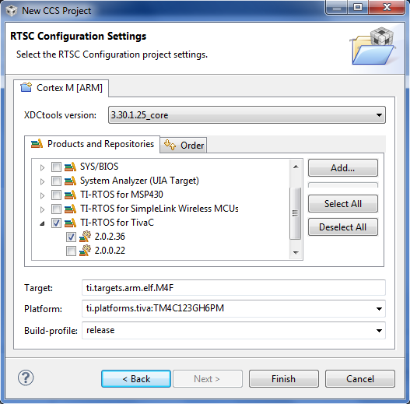
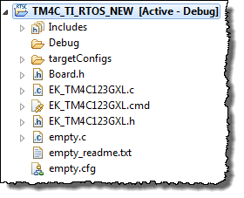

SYS/BIOS Project Settings
Select versions of XDC Tools and TI-RTOS (plus others if necessary)
Target, Platform and Build-profile are auto-selected
Platform Pkgs:
All MCU – auto chosen
C6000 – must choose and can customize
When you click “Finish”, you get the following project (driver example):
More on Platforms…

Slide 6
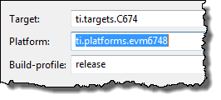
Memory Configuration (Platform Pkgs)
MCU Users:
Provided with a linker.cmd file to manage memory
Only “base” or “superset” MCU devices have platforms auto-selected
C6000 Users:
BIOS will create a linker.cmd file based on the settings in the PLATFORM pkg
When creating a new project, C6000 users will typically choose the default “seed” platform file as shown:
C6000 users can create their own CUSTOM platform package to modify:
Cache Settings
User-named sections
External Memory (DDR2/3)
Code, data, stack placement
Customize internal memory segments
Benefit? Optimization…
What is in the app.cfg file ?

Slide 7
Outline
Creating A New Project
TI-RTOS Config (.CFG)
System Timeline
UIA & RTOS Analyzer
Version Control
Lab

Slide 8
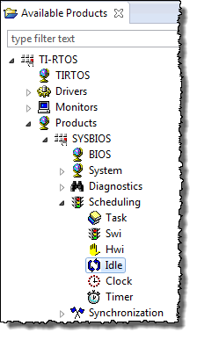
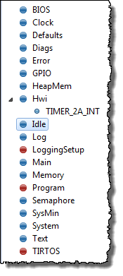
Static BIOS Configuration (.cfg)
The .cfg file contains all STATIC BIOS services used in the project
To ADD a service, right-click on service in Available Products and select “Use xyz”. It will then appear in your .cfg file (see Outline view)
.cfg
Note: you can also drag/drop services…
When you click on Idle…

Slide 9
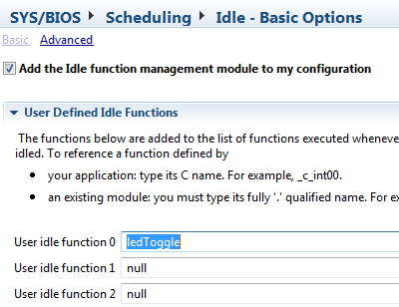
Static BIOS Configuration – Adding Idle Fxn
When you click on a service (or BIOS module) in the Outline view, you can then configure its settings (e.g. adding an Idle function):
.cfg

Slide 10
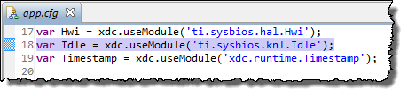
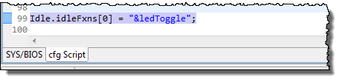
Static BIOS Configuration – Adding Idle Fxn
All changes made to the GUI are reflected in the script (.cfg file) and vice versa
Click on a module on the right and you can see the corresponding script in app.cfg:
.cfg
Note: .cfg files don’t “build up” entries like the older .tcf (DSP/BIOS) files did

Slide 11
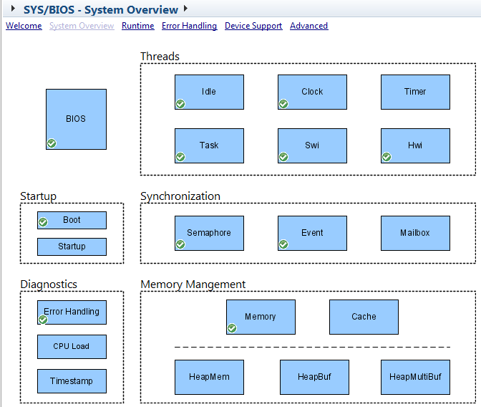
BIOS System Overview
To see the services used in YOUR .cfg file, choose:
BIOS → System O/V
Notice the green checkmarks (✓)

Slide 12
Configuration Build Flow (CFG)
SYS/BIOS – user configures system with CFG file
The rest is “under the hood”
USER
UNDER THE HOOD (TOOLS)
BIOS pkgs (.cfg)
Platform/Target
Build Options
XDC
Configuro
compiler.opt
.cmd
-I
-L
.C
Compiler
Linker
app.out
BIOS modules (like HWI, Clock, Semaphore, etc.) are delivered as RTSC compliant packages
RTSC – Real Time Software Components – Packages that contain libraries and metadata (similar to Java.jar files)
XDC – eXpress DSP Components – set of tools to consume RTSC packages (knows how to read RTSC metadata)
BIOS libs

Slide 13
Outline
Creating A New Project
TI-RTOS Config (.CFG)
System Timeline
UIA & RTOS Analyzer
Version Control
Lab

Slide 14
System Timeline
Hardware |  | Software
Reset H/W | BOOT MODE |  | Provided by TI | main.c |  | Provided by TI
Device Reset | Boot Loader |  | (_c_int00) BIOS_init() | System Init Code | BIOS_start() (Provided by TI) | SYS/BIOS Scheduler
(C6000)
RESET – Device is reset, then jumps to bootloader (optional) or code entry point (c_int00) to init SP and globals/statics
Most MCUs have on-chip Flash and therefore don’t use a bootloader
BIOS_init() – configs static BIOS objects, then calls main()
main()
User initialization
Must execute BIOS_start() to enable BIOS Scheduler & INTs

Slide 15
Outline
Creating A New Project
TI-RTOS Config (.CFG)
System Timeline
UIA & RTOS Analyzer
Version Control
Lab

Slide 16

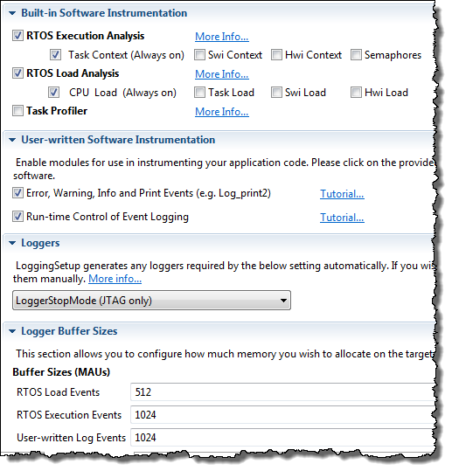

Configuring UIA & RTOS Analyzer
UIA (Unified Instrumentation Architecture) provides instrumentation APIs that run on the TARGET – Why? Visibility into what your program is doing (or not doing)
The RTOS Analyzer displays the results of these commands in CCS
Multiple transport protocols are supported – we will use STOP-MODE JTAG
(UIA)
Add “LoggingSetup” to your .cfg file, then config
Tasks take less memory to track, Hwi/Swi require bigger buffers
Buffers are circular
Logs...

Slide 17
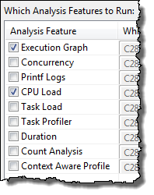
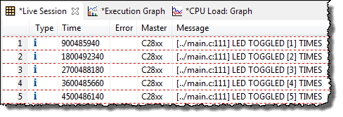
Using Logs
printf() is a popular debug tool, but it can cost cycles/code size on some MCUs and certainly is a bad idea on DSPs
Log_info() is ~40 cycles, provides similar benefits (allows 0-5 args):
Log_info1(“LED TOGGLED = [%u] TIMES”, toggles);
Halt, choose proper tool via: Tools → RTOS Analyzer → Execution Analysis (pick services here, “Live Session” shows Log_info results)
Display the filtered results:
Note: users can export log data to .csv file
Execution Graph…

Slide 18
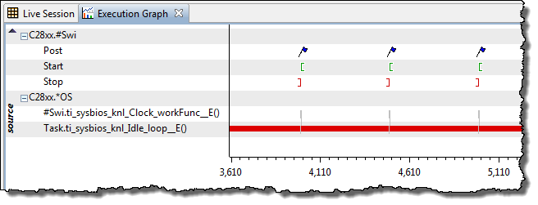
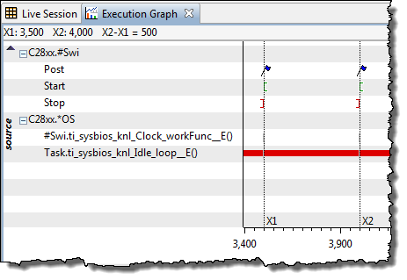
Using Execution Graph
Execution Graph is a software logic analyzer that provides visibility into almost every event in the system – down to the nanosecond.
Time basis (ns to ms)
Results are written to a system log, then displayed on the graph.
To view – halt, the use: Tools → RTOS Analyzer → Exec Analysis
Users can also BENCHMARK using markers on the graph
CPU and Thread Loading…

Slide 19
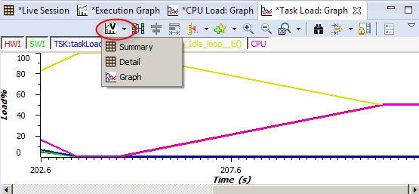
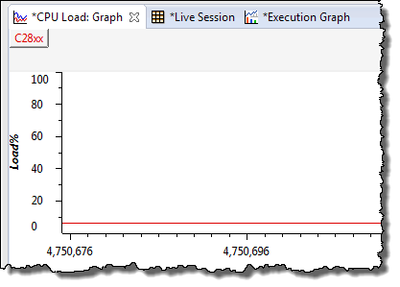
Using CPU/Thread Loading
Observing load can be done in two different ways:
CPU Load – calculates time NOT spent in the Idle thread
Thread Load – displays loading of individual threads
To use, first configure buffer size in LoggingSetup
Halt, use Tools → RTOS Analyzer → Load Analysis to see the results:
Note: you can also calculate the load dynamically using:
Load_getCPULoad();

Slide 20
Outline
Creating A New Project
TI-RTOS Config (.CFG)
System Timeline
UIA & RTOS Analyzer
Version Control
Lab

Slide 21
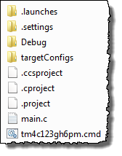
Suggested Files for Version Control
What you “check in” is up to you.
However, here are some suggestions:
\Project
Source Files:
*.c, *.h
.cfg (SYS/BIOS Config)
custom platforms
custom linker.cmd files
Eclipse (CCSv6) Files:
Project Files - .project, .cproject
CCS Project File: .ccsproject
Target Config Files
Project Settings: .settings
.launches – NO (debug connection)
Build Config folders: Debug/Opt/Release NO – generated when you build
YES
NO
42

Slide 22
Outline
Creating A New Project
TI-RTOS Config (.CFG)
System Timeline
UIA & RTOS Analyzer
Version Control
Lab

Slide 23
Lab 4 – Blink an LED Using Idle
Lab Goal:
This is your first TI-RTOS Kernel project – and you just want to blink an LED in Idle
Procedure
Create a new BIOS project (Minimal)
Add/link files (main.c, driverlib/folder)
Create Idle object (for fxn ledToggle)
Build, “Play”, Debug
Add UIA/SA to project and configure
Use Log_info() to print #toggles
main.c
main() {
init_hw();
…
BIOS_start();
}
Scheduler
Hwi
while(1) {}
Swi
ledToggle() {
toggle(LED);
delay(500ms);
Log_info();
}
while() loop replaced by Idle
Idle
Time: 60min

Slide 24


Slide 25
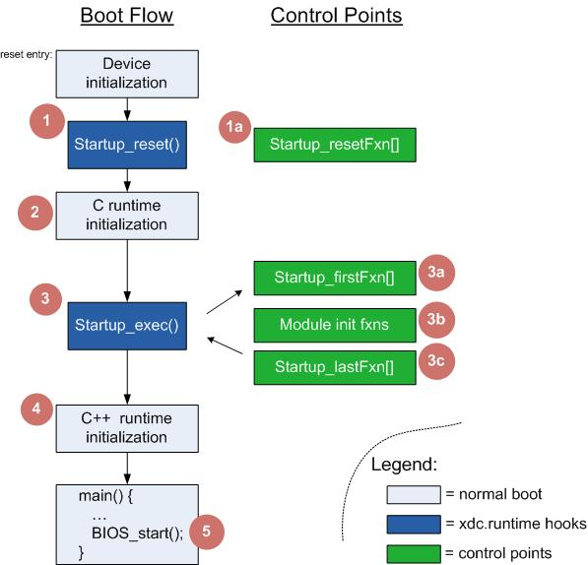
Boot Sequence
Described in detail in the User’s Guide and the Stellaris/BIOS wiki page

Slide 26
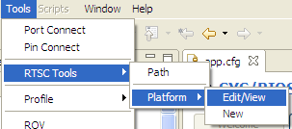
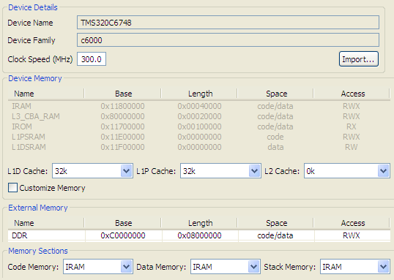
Platform (Memory Config)
Memory Config
Create Internal Memory Segments (e.g. IRAM)
Configure cache
Define Ext’l Memory
Section Placement
Link code, data, stack to any memory segment
Custom Platform
Use “Import” button to copy “seed” platform and then customize

Slide 27
Outline
MainHighlight
MainNormal
SubHighlight
SubNormal

